Slide 1
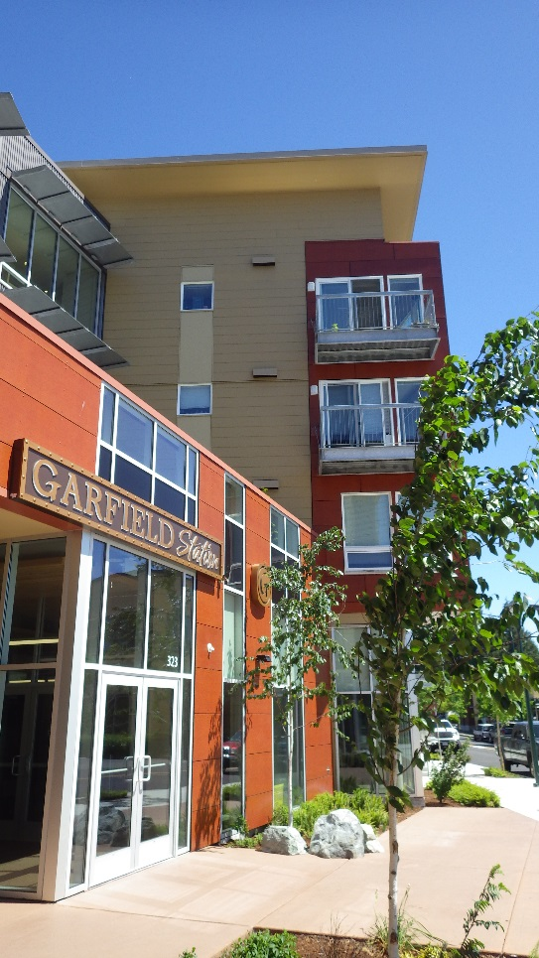
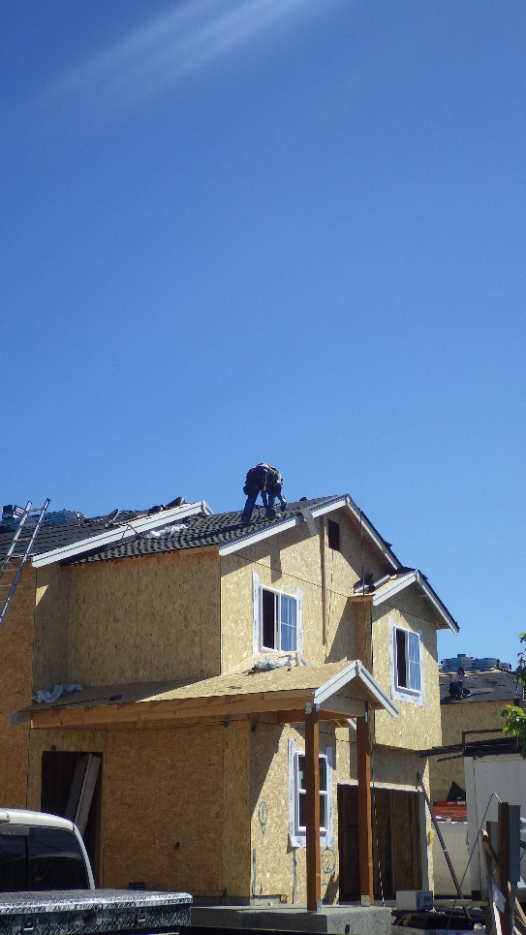
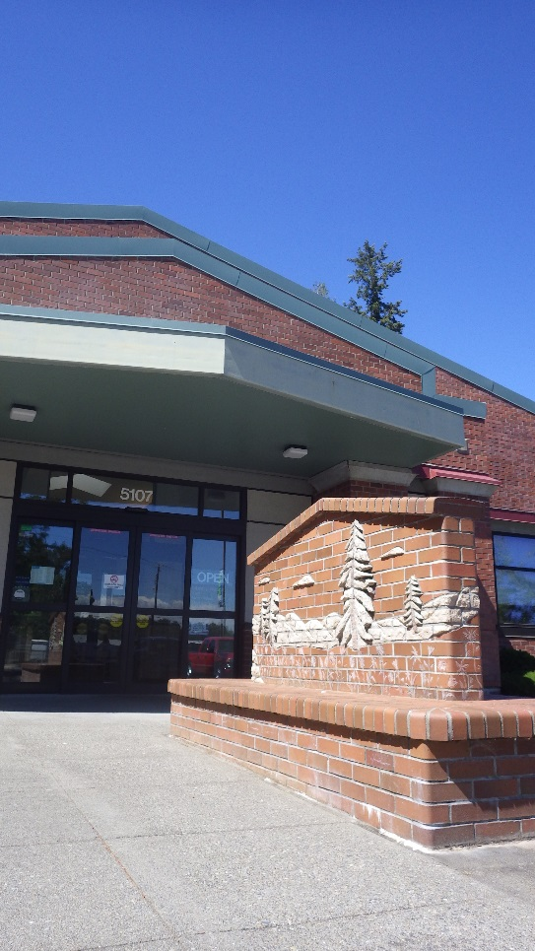
Community Plan Updates
January 4, 2019
Tiffany O’Dell, Senior Planner | Tiffany.Odell@piercecountywa.gov
Erik Jaszewski, Associate Planner | Erik.Jaszewski@piercecountywa.gov
Pierce County Planning and Public Works

Slide 2
What is a Community Plan?
Miniature Comprehensive Plan
for a specific sub-area of the County
Elements include:
Land Use: Zoning, allowed uses, density and dimension
Community Character: Design, historic resources, amenities
Economic Development: Employers, new businesses
Environment: Natural environment, areas to protect
Facilities & Services: Utilities, parks, public safety
Transportation: Infrastructure and service priorities
Background & History: information about the plan area
Notes:
Pierce County’s comprehensive plan provides details about county services and policies at a countywide level. Community plans act as miniature comprehensive plans that identify the same types of needs on a smaller, community-specific scale.
This plan is your opportunity to share with the county how you would like to see your community grow and develop in the future.
A lot of people are moving to our county, and we don’t see that trend slowing down. This is our opportunity to plan for how and where that growth should take place, so that we can ensure that Pierce County is a great place to live, work, and raise a family.

Slide 3
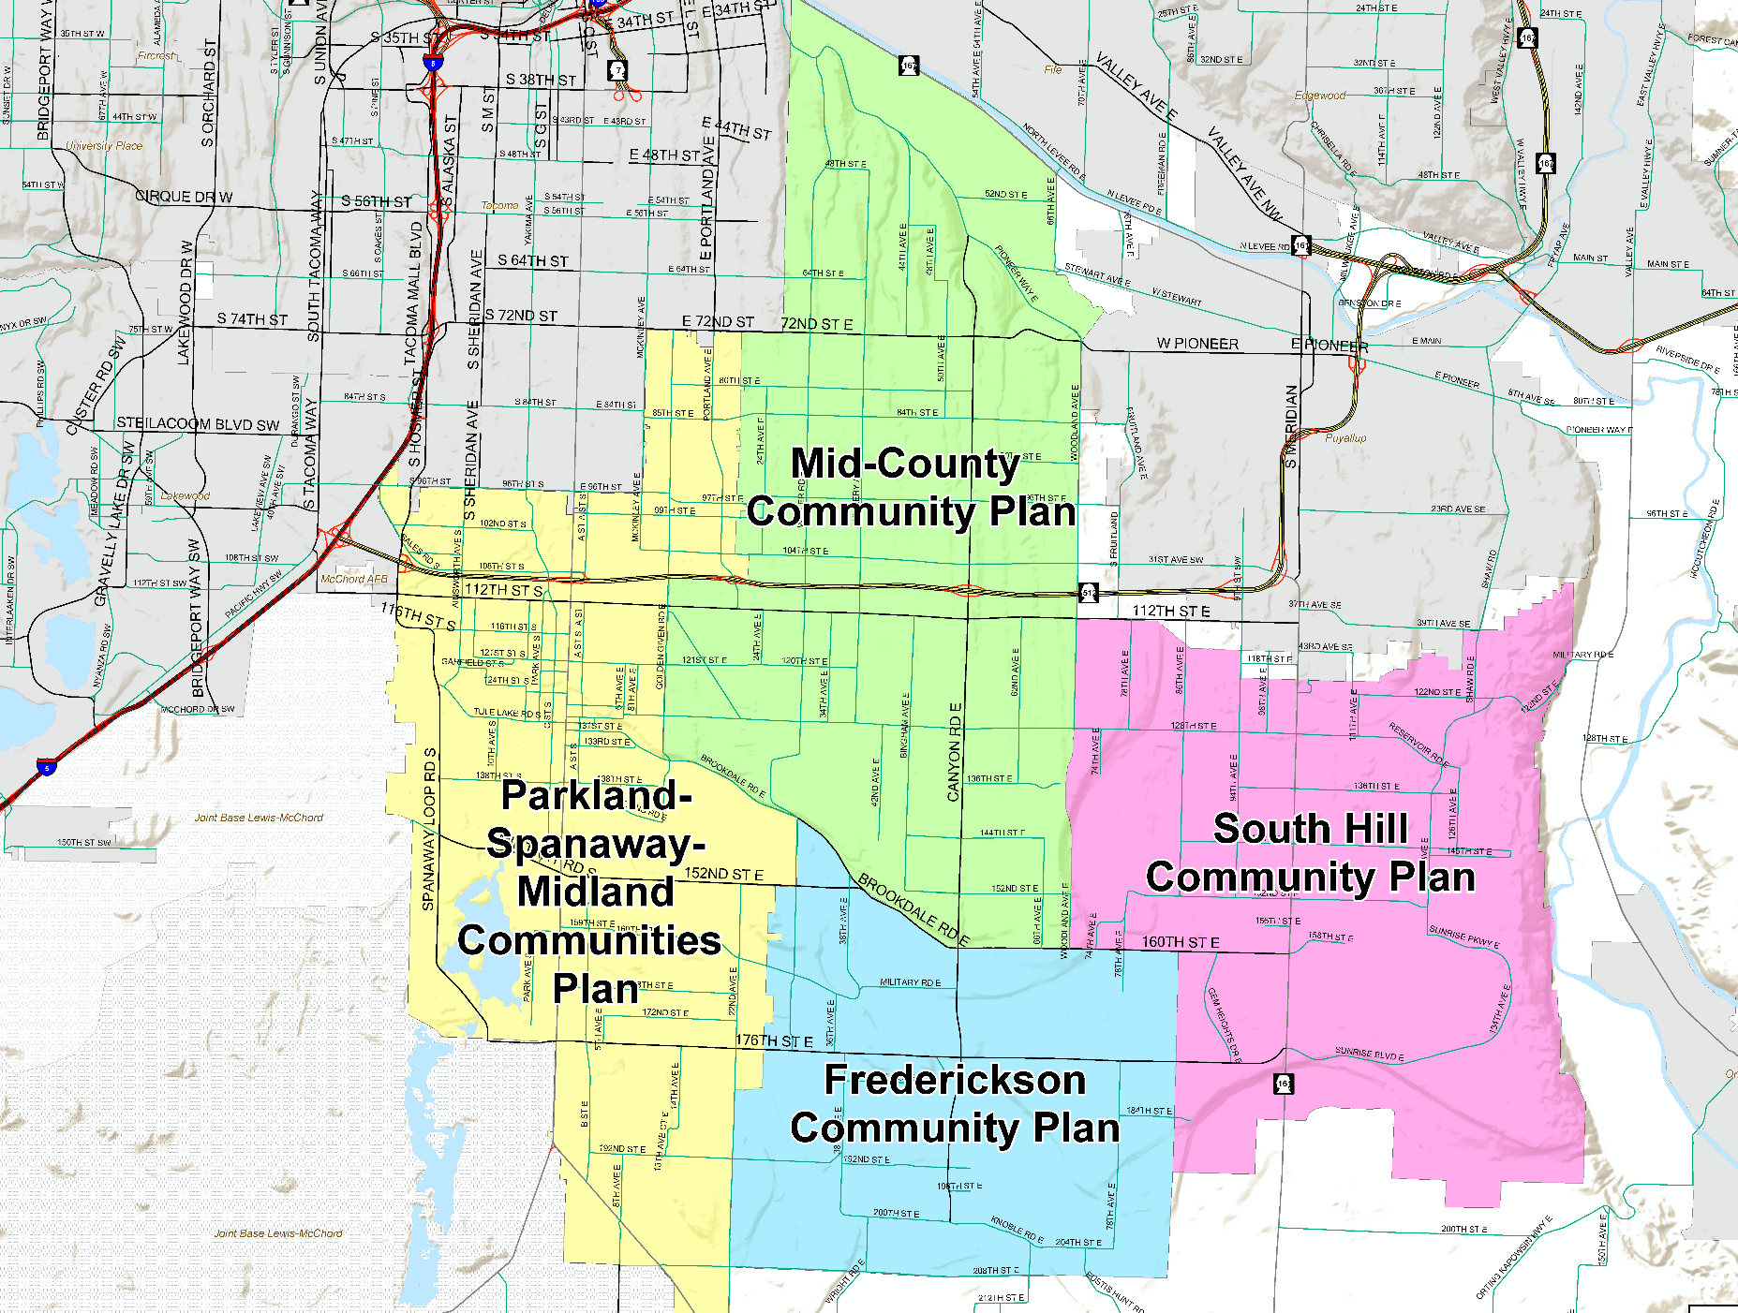
Community Plan Areas
Community Plan Adopted
2002: Parkland-Spanaway-Midland
2003: Frederickson
2003: South Hill
2005: Mid-County
2017 Stats
89% Urban
11% Rural
190,000 Total Population
55,700 Population Increase from 2000 (41.5%)
76,700
2017 Population
30,800
2017 Population
56,300
2017 Population
26,200
2017 Population
Notes:
Show of hands – where do you live? In these communities? Outside?
Pierce County is in the process of updating 4 community plans in the central area of the county.
Plans were adopted 10-15 years ago, and population in the area has increased by over 40% since.
Areas have similar issues and interconnection of the communities, so it made sense to work on them at the same time. This has been a huge undertaking and long process (started in 2016)

Slide 4
Update Status
Introduction
Identify Issues
Public Input
Environmental Impact Statement (EIS)
Draft Plan Updates & Development Regulations
Adoption Process
Public Meetings and Hearings
2016
2017
2018
2019
Notes:
This has been a long process – 4 community plans at once is a huge undertaking.
Started working with LUACs in 2016 to identify needed changes.
Major public outreach and community survey in Spring 2017.
Since, drafting plans and development regulations based on public and stakeholder feedback.
2019 final public meetings, hearings and adoption process.

Slide 5
Centers & Corridors Proposal
Notes:
As part of community plan updates, Pierce County introduced a new zoning concept – Centers and Corridors. The concept would concentrate growth along major transportation corridors and consolidate zoning in those areas.

Slide 6
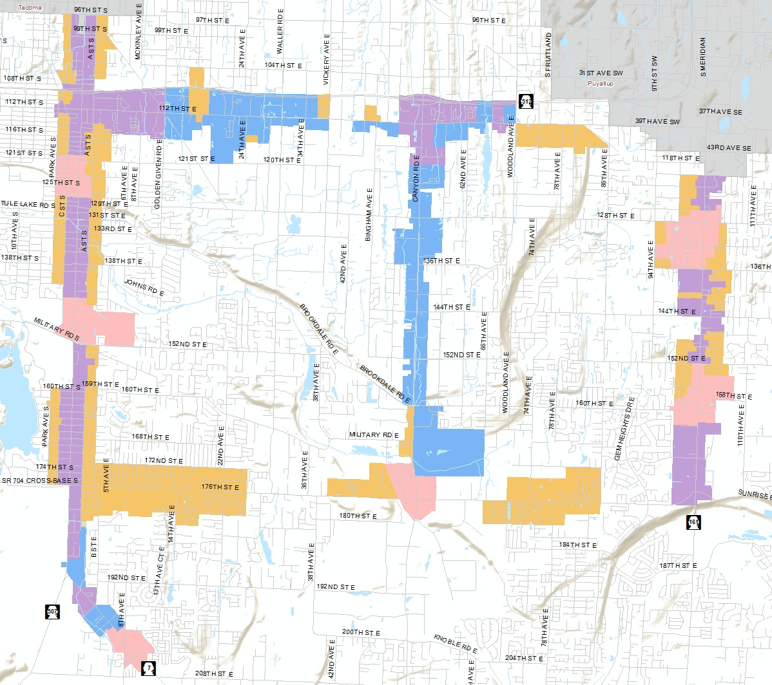
Centers & Corridors Proposal
Purpose
Focus growth along 5 major transportation corridors
Prioritize investments to provide efficient services
Encourage economic development
Increase transit viability and alternative transportation options
Support bus rapid transit on SR-7
Notes:
Areas within ¼ mile of Pacific Ave/Mt. Hwy, 112th Street East, 176th Street East, Canyon Road, and Meridian.
We heard from the community that they wanted to minimize impacts on existing single family neighborhoods. This proposal does impact neighborhoods within ¼ mile of these transportation corridors, but keeps zoning single family in areas outside of that ¼ mile radius.
To provide urban infrastructure to this huge urban area is difficult, Pierce County needs to be able to prioritize investments where growth will happen. This approach allows services like sewer and bike and pedestrian facilities to be concentrated in specific areas, making it more cost-effective to do extensions.
The proposal also:
Increases variety of housing choices – not just single family or apartment, more townhouses, small units, etc. Allows the market to determine needed housing types within these areas, but keeps single family neighborhoods outside of the corridors single family.
Supports economic development and job growth – more flexible zoning concept based on building function than on the use in the building, because building tenants change over time.
Increases viability for alternate modes of transportation – greater investments in bike and pedestrian facilities, and housing and services at a density that makes transit service viable
Increases access to funding – by designating centers of local importance, Pierce County becomes more competitive for regional transportation funding that makes needed improvements more likely
Streamlines commercial and multifamily zoning – makes it easier for property owners to understand what they can do with their property and provides them with more flexibility on allowed uses when their site design meets more rigorous design standards.
Capital facilities, transit, transportation, infrastructure…

Slide 7
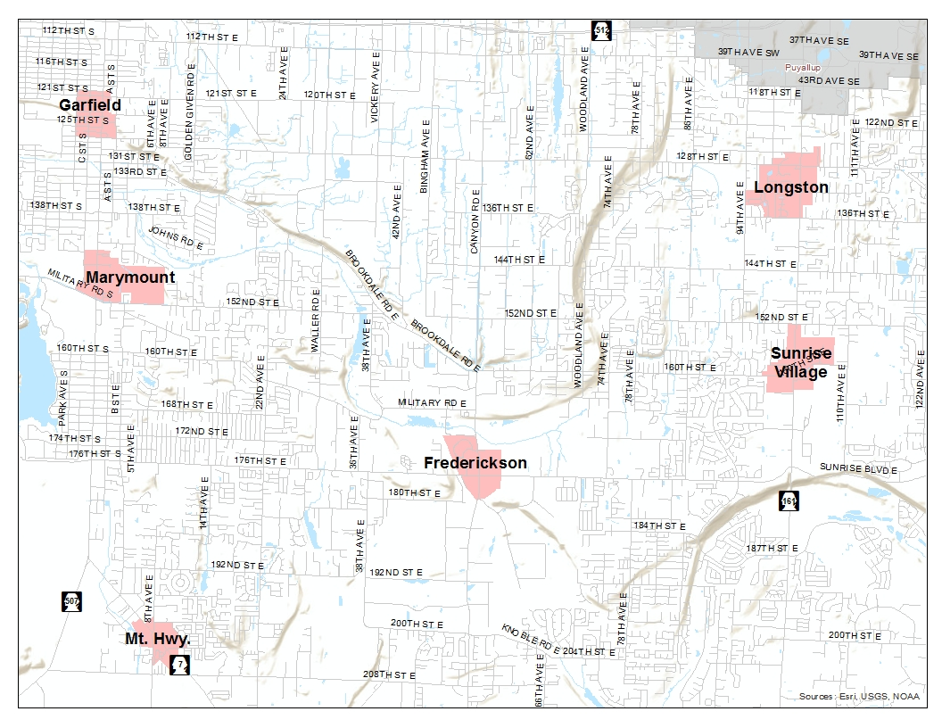
Proposed Zones
Centers
Towne Center (TCTR):
Central place, live, work, services, parks/recreation
Commercial, civic, and high-density housing
Walkable and transit-oriented
Transportation funding
Map boundaries shown are draft as of 11/1/18
Notes:
Centers are areas where we want to see the most growth – areas where people can live, work, and play – that act as a central gathering place for community.
Centers include a mix of uses that draw people to them – think shopping, restaurants, professional services, recreation, and high density housing.
6 proposed Towne Centers: Garfield, Marymount, Mountain Highway, Frederickson, Longston, and Sunrise Village
Proposed as Centers of Local Importance, which will make these areas more competitive for regional transportation grants, potentially getting transportation projects built more quickly.
These areas expand on center-type zoning in each of the community plans adopted 10-15 years ago, but may expand the boundaries and allow more high density housing than proposed previously. This plan also makes these areas the highest priority for infrastructure like sewers and sidewalks.

Slide 8
Proposed Zones
Corridors (3 Zones)
Employment (ECOR): industrial, professional offices
Neighborhood (NCOR): all housing types, neighborhood services, and civic uses
Urban (UCOR): multifamily, townhomes, commercial, office, and civic uses
Map boundaries shown are draft as of 11/1/18
Notes:
Increased or unlimited densities, upzones, transit, streamlined permitting process, market, reduce barriers to housing
Small-lot “lite”

Slide 9
Regulatory Details
Zone | Min. Density | Max. Density | Max. Height
Towne Center (TCTR) | 20 units/acre | Unlimited | 65 feet*
Employment Corridor (ECOR) | N/A | N/A | 65 feet
Urban Corridor (UCOR) | 12 units/acre | Unlimited | 45 feet*
Neighborhood Corridor (NCOR) | 6 units/acre | 25 units/acre | 45 feet
*may be increased an additional 20 feet through
PCC 18A.65, Affordable Housing Incentives
Details shown are draft as of 11/1/18
Notes:
Pierce County allows housing to be built in different zones based on “density”
The density calculation is a little more complicated, but generally, a single family neighborhood with ¼ acre lots is about 4 units per acre.
Most of the 2-3 story apartment complexes in unincorporated Pierce County are 12 to 15 units per acre (depending on unit size)
Most townhouse complexes have densities of 12-18 dwelling units per acre
Higher density apartment complexes like the one that went in on Garfield Street have 60 or more dwelling units per acre.
These new zones introduce higher densities than what is allowed today. Most multifamily zones in Pierce County today allow a maximum of 25 units per acre.
What you should expect to see for residential development in these new zones:
-Towne Center: High density apartments ranging from 2-3 story larger unit apartments like those you see in many neighborhoods today to 6-8 story complexes like you see at Garfield North or Point Ruston with units ranging from larger units to microunits with more shared facilities providing affordable housing.
-Employment Corridor: No new housing units are allowed, but buildings may be as tall as 6 stories
-Urban Corridor: Townhouses, traditional 2-3 story apartment complexes and high density apartment complexes in buildings as tall as 4-6 stories
-Neighborhood Corridor: Mix of small lot single family detached houses, duplexes, triplexes, townhouses, and up to 4 story apartment complexes.

Slide 10
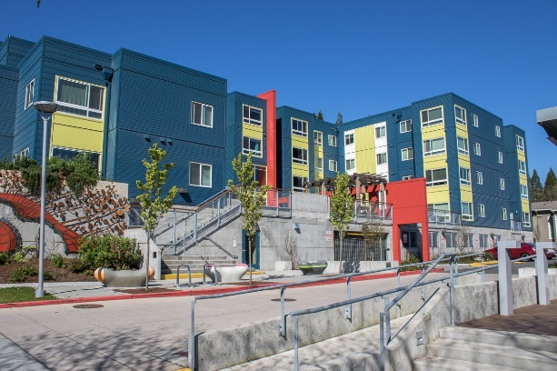
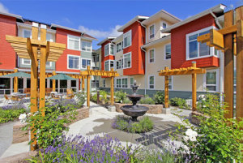
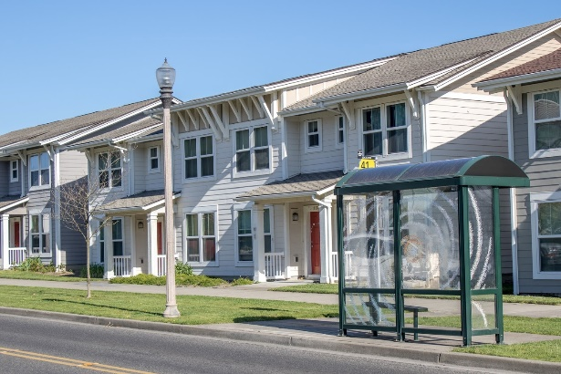
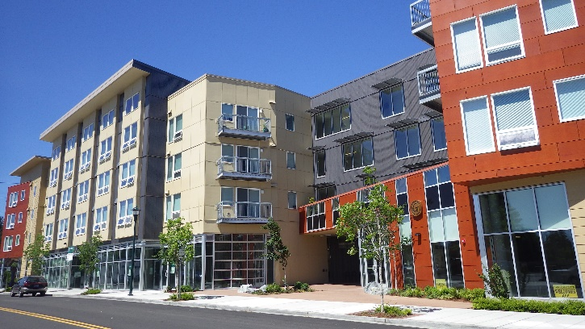
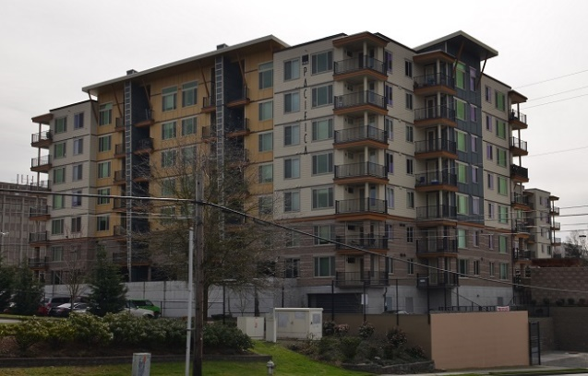
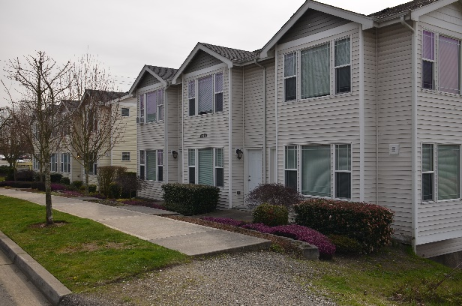
Height Bonus for Affordable Housing
Towne Center and Urban Corridor zones only:
10 ft. increase for 10% affordable housing – TCTR 75 ft. / UCOR 55 ft.
20 ft. increase for 20% affordable housing – TCTR 85 ft. / UCOR 65 ft.
Notes:
3 new corridor zones replace a multitude of commercial and multifamily zones in existing codes. Focus on site and building design over uses. Still does not allow things with high impacts to locate next to things that are incompatible without significant buffering, but recognizes that buildings often last longer than the uses located within them.
Employment Corridor – 112th Street East, Mountain Highway, and Canyon Road – concentrated place for employers, including professional offices and industrial uses. No housing allowed.
Neighborhood Corridor – Generally 1 block off of Pacific Ave and Meridian acting as a buffer between higher intensity uses along major road and single family residential neighborhoods. Allows mix of housing types, civic uses, and neighborhood scale commercial and services. Also along 176th & 112th St.
Urban Corridor – Generally first block of uses along Pacific and Meridian and around intersection of 112th & Canyon. Allows a mix of commercial and high density multifamily uses – more auto-oriented and lower height and density than Towne Center.

Slide 11
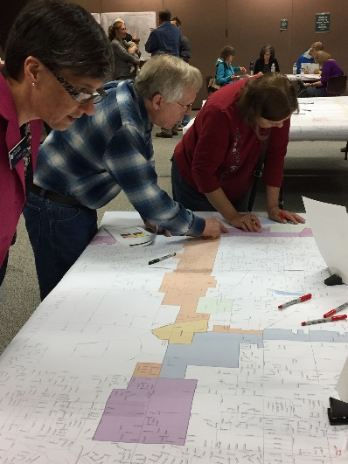
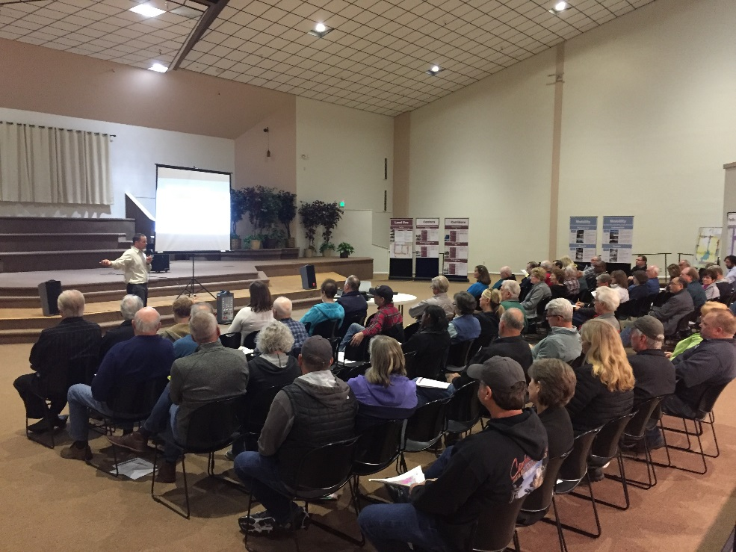
Get Involved
Upcoming Outreach
EIS
Mail rezone notices
Community groups outreach
Social media
Press releases
Updated website
Online open house & survey
Public open houses
Public hearings
Notes:
Ramping up for public outreach…
-once LUACs have determined which rezone requests will be included in their draft that will go to public meeting, rezone notification postcards will be sent to all property owners with hearing dates
-we will reach out to community and stakeholder groups we know of and offer presentations and updates to those groups
-we’ll promote the process via social media, industry notices, interested parties list, media, and our website (no budget for community-wide mailing again)
-Launch online and in-person open houses for people to get up-to-speed before public meetings and hearings begin
-public meetings before LUACs
-public hearings before Planning Commission
-final public hearings and adoption process before County Council

Slide 12
Other Efforts
Notes:
As part of community plan updates, Pierce County introduced a new zoning concept – Centers and Corridors. The concept would concentrate growth along major transportation corridors and consolidate zoning in those areas.

Slide 13
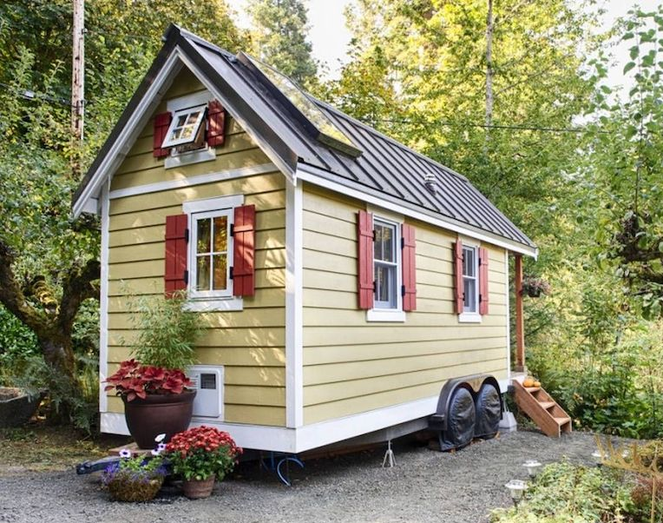
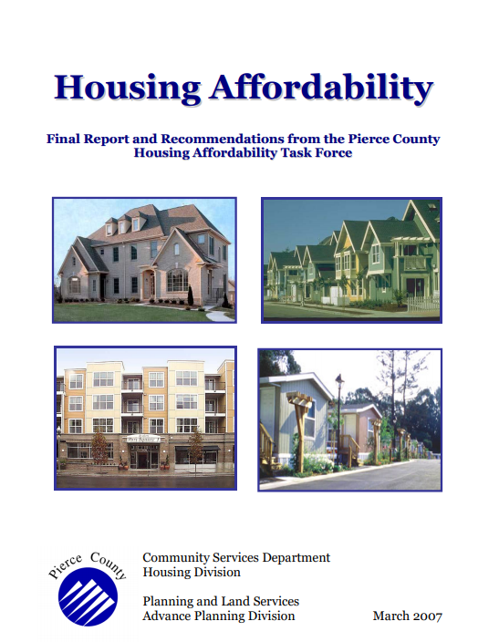
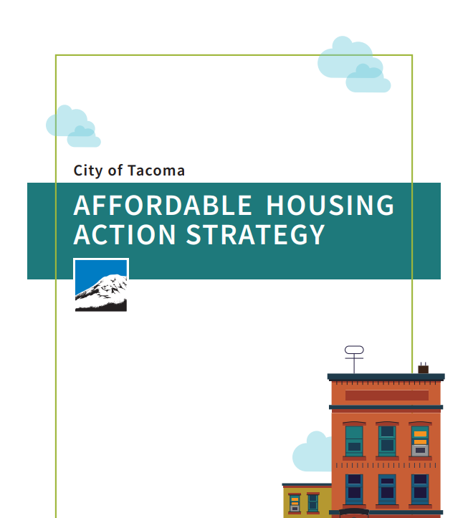
Other Efforts
Fee Waivers Available for 2019
-Monitoring effectiveness
Tiny Homes
-Guidance for Applicants
-Necessary Code Changes?
Local and Industry Best Practices

Slide 14
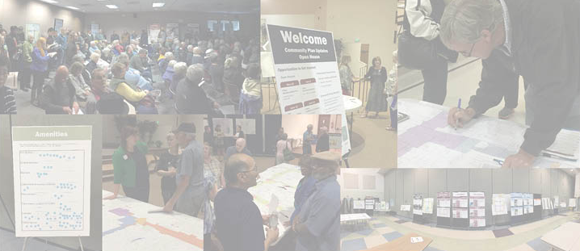
Questions
Visit our website and subscribe for updates:
www.piercecountywa.gov/cpupdate
Tiffany O’Dell, Senior Planner | Tiffany.Odell@piercecountywa.gov
Erik Jaszewski, Associate Planner | Erik.Jaszewski@piercecountywa.gov
Pierce County Planning and Public Works
Notes:
Questions?
Contact me with questions, rezone requests, community groups that might want a presentation, etc.

