Slide 1
COVID-19 Working together to protect our community’s health
Lori Karnes & Marianne Seifert,
Tacoma-Pierce County Health Department
Ivan Tudela, Department of Emergency Management, Pierce County
March 6, 2020
Notes:
Things to emphasize over and over:
80% of people have very mild symptoms
We are not in a pandemic. While you don’t need to panic, you do need to plan.
It is not time to close businesses and shut down gatherings. We need to plan in case that becomes necessary.

Slide 2
Plan for today
What is COVID-19?
How it spreads.
Evolving situation in our region.
Public health role.
Plan and prepare.
Non-pharmaceutical interventions.
Protect yourself.
Organizational preparedness steps.
Share accurate information.
Addressing accessibility needs.
Questions.
Notes:
Outline CoVID-19 and weekend updates.
What we are doing.
Role of health officer and public health.
Areas emergency management can support.
NPIs/pandemic planning.
What they can do right now.
Communications.
Community engagement.
Questions.
What is COVID-19?
How it spreads.
Evolving situation in our region.
Role of health officer and public health.
How emergency management supports.
What can you do?

Slide 3
How to participate during the talk
If you have questions, write them down so you don’t forget them.
We will have a lengthy question and answer session at the end.

Slide 4
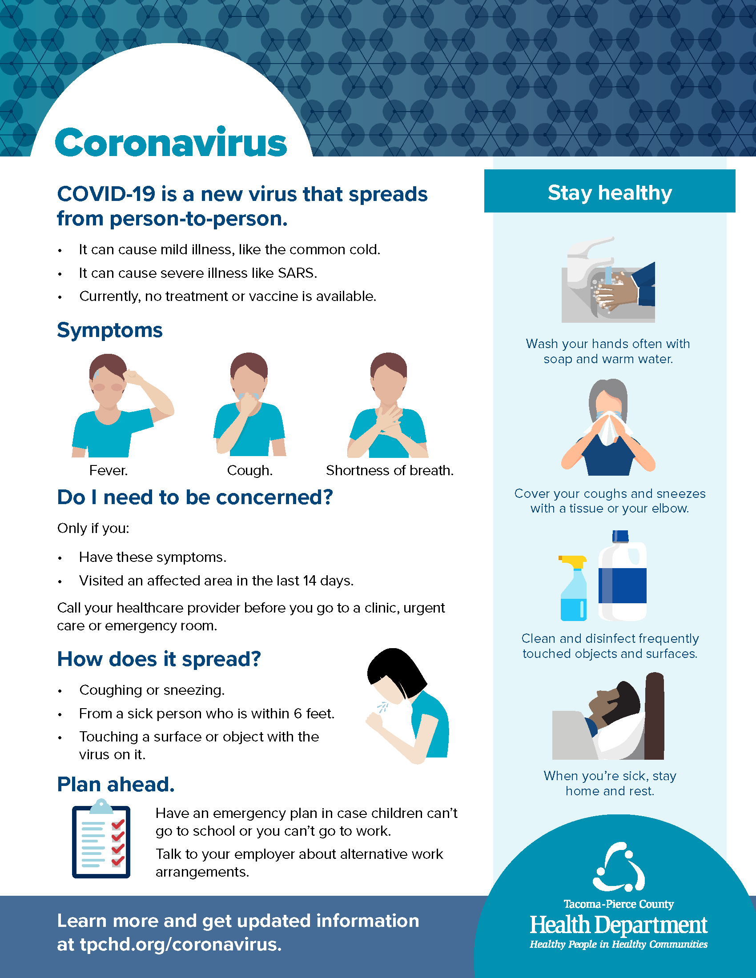
What is COVID-19?
Coronaviruses form a large family of viral illnesses that includes the common cold.
A new virus caused an outbreak in Wuhan, China and is now spreading internationally.
The current risk of COVID-19 in Washington is increasing.
Notes:
COVID-19 is a new coronavirus that caused an outbreak in Wuhan, China in 2019.
Coronavirus is a family of viruses that cause common cold symptoms.
Thousands of infections have been reported in China and are spreading to other countries.
On January 21, 2020, the first case in the United States was confirmed in Snohomish County.
The current risk of COVID-19 in Washington is increasing.
Pierce County has no cases of COVID-19. Public health is identifying more positive cases of the disease in the state. These new cases suggest the disease is spreading in Washington.

Slide 5
How does it spread?
Coronaviruses commonly spread from an infected person to others through:
Coughing and sneezing (within 6 feet).
Close personal contact, like touching or shaking hands.
Touching an exposed object, then touching your mouth, nose or eyes before washing your hands.
Rarely, fecal contamination.
Notes:
Since this is a new virus, much is to be learned and health officials are closely monitoring its transmission.
What we know from other coronaviruses is they spread through the same methods as the common cold.
The virus can spread through:
The air, from coughing and sneezing.
Close personal contact, like touching or shaking someone's hand.
Touching an object or surface with the virus on it.
In rare cases, contact with feces can also spread the virus.

Slide 6
Symptoms
Cough.
Fever.
Shortness of breath.
Causes asymptomatic, mild, severe and fatal illness.
Most people have mild symptoms.
Notes:
Pierce County’s risk of coronavirus is low.
Symptoms of other coronaviruses vary from mild common cold symptoms to severe respiratory issues.
80% of cases are mild.
Symptoms of this new coronavirus, COVID-19, include runny nose, headache, cough, sore throat, fever and a general feeling of being unwell.

Slide 7
Evolving situation
First United States case was in Snohomish County. Person has recovered.
First United States death was in King County.
There is community spread of COVID-19 in King County.
The risk to the public is increasing.
With expanded testing guidance, we expect to identify more cases.
Stay up-to-date on the latest information on our site. We continue to evaluate individuals with our healthcare partners.

Slide 8
Increasing health risk
Serious public health threat to the United States.
Increasing health risk to the general public in Washington.
Strategy is shifting from containment to mitigation.
Containment:
Individual focused interventions to limit spread.
Mitigation:
Community based interventions to slow and reduce the spread.
Notes:
Source: www.cdc.gov/coronavirus/2019-nCoV/summary.html#risk-assessment

Slide 9
Health Officer’s role
Exercise powers and perform duties vested in the local Health Officer in RCW 70.08.020.
Issue standing orders.
Dispense medicines, vaccines and controlled medicines to prevent, mitigate or treat disease in Pierce County.
Translate scientific and evidence-based health information for responders and policy makers.
Take/direct mitigation strategies to lessen the impact of an incident/outbreak.
Implement isolation and quarantine orders.
Manage health and medical system.
Maintain public and environmental health and sanitation.
Provide situational awareness, collaboration and emergency messaging for health and medical system.
Notes:
Cordon sanitaire

Slide 10
Public health’s role: Overview
Plan for possible cases and contacts.
Respond to concerns and investigate possible cases.
Implement control measures to prevent spread.
Coordinate with other local health jurisdictions and state and federal agencies.
Reach out to healthcare providers with disease monitoring and screening guidance.
Keep public informed with timely and accurate information.
Notes:
This is the work we do every day—whether it’s an emergent issue, like COVID-19, or diseases.
While much attention is focused on public health right now because of this emerging disease threat, the substance of what we’re doing to respond to COVID-19 is made up of what we do every day.
Just as we do for measles, Ebola, lead concerns in water and other concerns, public health follows a playbook to plan for responding to and controlling public health risks. We practice from this playbook often, for everything from measles outbreaks and environmental threats to emerging disease threats like COVID-19.

Slide 11
Public health’s role: Detect emerging issues
Monitor ongoing flows of data.
Epidemiologists analyze to detect patterns.
Informed medical providers and stakeholders report to us.
24/7 on-call staff to respond.
Activate emergency response plan and systems to respond.

Slide 12
Plan and Prepare
Non-pharmaceutical interventions are public health actions used when there is not medication to prevent and treat a disease like CoVID-19.
Public health is preparing for the use of these interventions to respond to CoVID-19.

Slide 13
Community Mitigation Goals

Slide 15
Public health terminology: Accuracy matters
Isolation—Separating a person known or believed to be infected with a communicable disease and potentially infectious from those who are not infected to prevent spread of the communicable disease.
Quarantine—Separating a person believed to have been exposed to a communicable disease but NOT YET symptomatic, from others who have not been exposed, to prevent the possible spread of the disease.
Home isolation or quarantine is always the preferred choice—We call it home monitoring. Obviously, we need alternatives for people living homeless.
Notes:
You’ve heard terms tossed about.
We can break this down to help everyone understand how we use different public health interventions.
State Department of Health is prepared to receive travelers under quarantine who cannot be quarantined at home.

Slide 16
Interventions
Personal:
Home isolation of ill people, hand hygiene, resp. etiquette.
Home quarantine of well, potentially-exposed people.
Community social distancing:
School closures and dismissals.
Social distancing in workplaces.
Postponing or cancelling mass gatherings.
Environmental measures (e.g., routine cleaning of frequently touched surfaces).
Notes:
We have not recommending these social distancing measures yet (as of 3/5/20) - however we are asking folks to prepare in case we need them.

Slide 17
Personal Protective Equipment
Not recommending masks for the public.
Manufacturers allocating Personal Protective Equipment at 100% of normal orders but most on back order.
Federal partners working to increase PPE production.
Strategic National Stockpile:
Washington allocation unknown.
Not distributing resources at this time.
Healthcare systems are being asked to conserve PPE.

Slide 18
What to do if you are sick or suspect you are infected with coronavirus?
If you have a cough, fever or other symptoms:
Call your regular doctor first and wear a protective mask when going to the appointment to avoid infecting others.
Do not got to the emergency room, as it needs to be able to serve the most critical needs.
Notes:
Many people are understandably anxious about coronavirus, but flu and colds have similar symptoms. Most people infected with coronavirus have mild illness - about 80%. A smaller portion have severe illness.

Slide 19
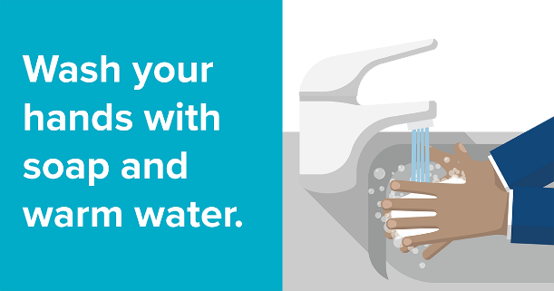
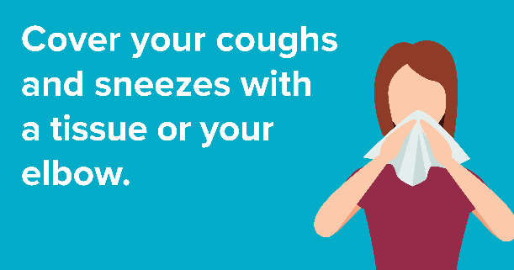
What can you do?
Wash your hands more. Touch your face less.
Notes:
EXTRA EMPHASIS on this with extra slide??
Handwashing sign that show germs. Or the food infographic that show all the times when you should.
-After using the bathroom.
-Before and after preparing food.
-After sneezing or coughing.
-Avoid shaking hands [Note - added by Anne via comment]

Slide 20
Personal Preparedness: Don’t Spread Germs
Wash your hands often with soap and water for at least 20 seconds.
Avoid touching your eyes, nose, or mouth with unwashed hands.
Avoid close contact with people who are sick.
Cover your coughs and sneezes.
Clean and disinfect objects and surfaces.
Stay at home and away from others if you are sick. Call your healthcare provider before going to the emergency department.
Notes:
Wash your hands often with soap and water for at least 20 seconds.
Avoid touching your eyes, nose, or mouth with unwashed hands.
Avoid close contact with people who are sick.
Avoid close contact with others.
Cover your coughs and sneezes.
Clean and disinfect objects and surfaces.
Stay at home and away from others if you are sick.
Handwashing graphic.
The new coronavirus is not spreading widely. There is flu circulating in our community and it is important to protect yourself from the flu. To protect yourself, wash your hands with soap and water for at least 20 seconds. If no soap is available, use hand sanitizer as an alternative. Avoid touching your eyes, nose, or mouth if you have not washed your hands. Also avoid contact with people who are sick. If you get sick, stay home and avoid contact with other people to prevent spreading your cold. Always cover your mouth and nose with a tissue or sleeve when coughing or sneezing.

Slide 21
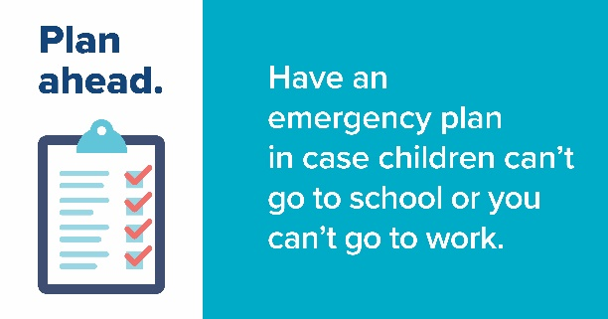
Personal Preparedness: Get Ready!
Plan to have extra supplies of important items on hand.
Plan ways to care for those at greater risk for serious complications.
Get to know your neighbors.
Be prepared for your child’s school or childcare facility to be temporarily dismissed.
Discuss sick-leave policies and telework options with employer.
Notes:
Don't panic, be prepared! [Added by Anne]

Slide 22
Organizational preparedness
How do you reduce the spread of disease?
What should you prepare for?
How will you stay open? (continuity of operations planning)

Slide 23
How do you reduce the spread of disease?
Preparation Stage
Keep up what we already talk about!
Arrange clients from head to foot. Use maximum spacing.
Clean and disinfect– just like for hepatitis A.
Educate clients and staff on handwashing, respiratory etiquette.
Put up signs!
Promote food safety—just like for hepatitis A.
Notes:
Arrange clients from head to foot so people’s heads aren’t lined up next to each other – reduce respiratory spread
Cleaning and sanitizing well is the single most important thing you can do.
Create a cleaning and sanitizing protocol. Include a schedule and a sign-off so you know when it gets done on time.
Make sure all volunteers and staff who are cleaning have received the same cleaning and disinfecting guidance.

Slide 24
How do you reduce the spread of disease?
Develop entry protocol. Consider closing secondary entrances.
Screen for symptoms upon entry—cough, fever, difficulty breathing.
Wash/sanitize hands when you enter the building.
Social distancing.
Arrange clients head to foot. Use maximum spacing.
Separate sick people. Create physical barriers if necessary.
Prepare to minimize shared gatherings in programs with individual units or apartments.
Collect supplies where possible.
Notes:
[Notes for presenters] We're not asking you to turn people away who have symptoms. People with mild symptoms should receive extra hygiene and cough/sneezing etiquette reminders and separated via social distancing recommendations. Ask sick people to wear a mask if you have them [reference coughing sign]. People with severe symptoms should be helped to safely access healthcare. Keep in mind there are many different reasons someone may have a cough – COPD, etc.

Slide 25
What should you prepare for?
Financial impacts on your clients who work.
More people seeking services.
Employee absenteeism.
Offer clear guidance about work at home and leave policies.
Notes:
If businesses close or reduce hours this could have financial impacts on your clients who work.
People who do not tend to access services may reach out for support or supplies.
Employee absenteeism may affect your agency.
Clients may have less information on COVID-19 than the general public and rely on you as a trusted source of information.

Slide 26
How will you stay open?
Plan for continuity of operations.
Notes:
Pierce County place holder.
If Sara isn't there – Ivan will help.

Slide 27
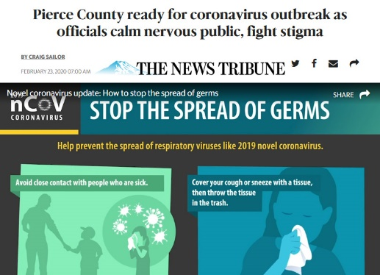
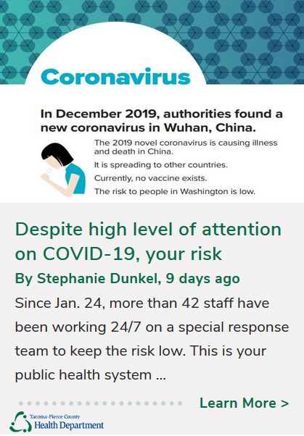
Share accurate information
We need your help! You are a trusted sources of information for your clients.
Rely on and share trusted sources of information.
www.tpchd.org/coronavirus.
Subscribe to our alerts. Follow and share our blogs, social media.
Speak up if you hear, see, or read stigmatizing or harassing comments or misinformation. Don’t make assumptions about someone’s health status based on their ethnicity, race or national origin.
Show compassion and support for affected people and communities.
Avoid stigmatizing people who are in quarantine, isolation or home monitoring.
Notes:
We need your help! Just like during hepatitis A outbreaks and getting the information out about influenza, we need all of you, especially outreach workers to unsanctioned encampments, to get the word out about coronavirus. Take our flyers with you – spread the word. People unsheltered are often don’t have the same access to information as everyone else.
We need you to tell us what you information you need to do this well.

Slide 28
Best Practices to Consider: CoVID-19 accessible communications tips
•Inclusive, accessible messaging.
•Website and social media access.
•Meetings and public events accessibility checklist.
•Press conference procedure checklist.
Notes:
Ivan/PCEM slide
From Anne: mention graphics in other languages and that are website has a translation feature

Slide 29
Help your clients with their health and wellness:
• Medications.
• Health plans: nurse consultation.
• Communication.
• Supplies.
• Alternate communication options.
• Dialysis centers or chemo.
• Considerations for people who require support with daily living activities.

Slide 30
Resources
Disability Integration resource.
http://www.jik.com/c19.html
American Sign Language State registry.
https://fortress.wa.gov/dshs/odhhapps/Interpreters/Contractors.aspx
Hearing, Speech and Deaf Center of Tacoma.
https://www.hsdc.org/

Slide 31
FAQs
Where will unsheltered people be isolated when sick with COVID-19?
We have a small amount of existing options for initial cases that we can use if necessary. We tackle this same issue often with TB cases, so we’re aware of the needs that would need to be addressed. We are working with city and county partners to look at obtaining the additional resources that we will need in the event of a pandemic.
Would it help if we opened more day shelters or expand hours?
In the event of a pandemic we will want to consider increasing social distancing and canceling or postponing large gatherings. We would not want to increase gathering at day shelters.
Should we increase the amount of showers available?
Resources are better spent focusing on frequent and proper cleaning and sanitizing and offer access to hand hygiene.

Slide 32
FAQs
Where can you go for information?
Refer to our tpchd.org/coronavirus page. Share new email address. We understand social services have specific needs and will find a way to stand up a resource portal that works for you. Continue to send us your needs.
When should we close?
We will work with you on a case-by-case basis. We need to consider ethical and economic considerations. You provide important safety net services. We are here to support you and we ask you to make these decisions with public health involvement. We will be working with you on staffing challenges in the coming weeks.
Notes:
Other questions you might get:
Whats happening at camp murray? The state hosts their emergency management out of Camp Murray – that’s likely why the governor is there.
What about safe parking? We need more shelter beds etc etc – “We are working with city and county partners to identify solutions. Please continue sending us along with the city and county your requests and ideas.”
Does COVID-19 require special disinfectant? As of 3/5, Centers for Disease Control and Prevention (CDC), is not recommending any additional disinfection beyond routine cleaning at this time. What is especially important is making sure you clean and sanitize frequently and follow the package label on your cleaning products. However, WA is still experiencing an outbreak of hepatitis A among people living homeless. In the workplace you will want to use steps to kill hepatitis A (see infographic).

Slide 33
Learn More
www.tpchd.org/coronavirus

Slide 34
Thank You!
Questions?
Community Engagement Team
coronavirus@tpchd.org
Emily Less
(253) 625-1362
eless@tpchd.org
Notes:
Emily may not always be available – she’s sick right now. Please email this inbox. Do not share with the general public. This email is for partner organizations only. We want to make sure we can get to your requests

