Slide 1

not Gerrit Nyland
gnyland@pchomeless.org
253-304-5105
Of Homelessness in Pierce County

Slide 2

If you take Nothing else away from this…
We must charge and resource someone to end homelessness in Pierce County
Data tells us the need – we must monitor weekly if not daily

Slide 3
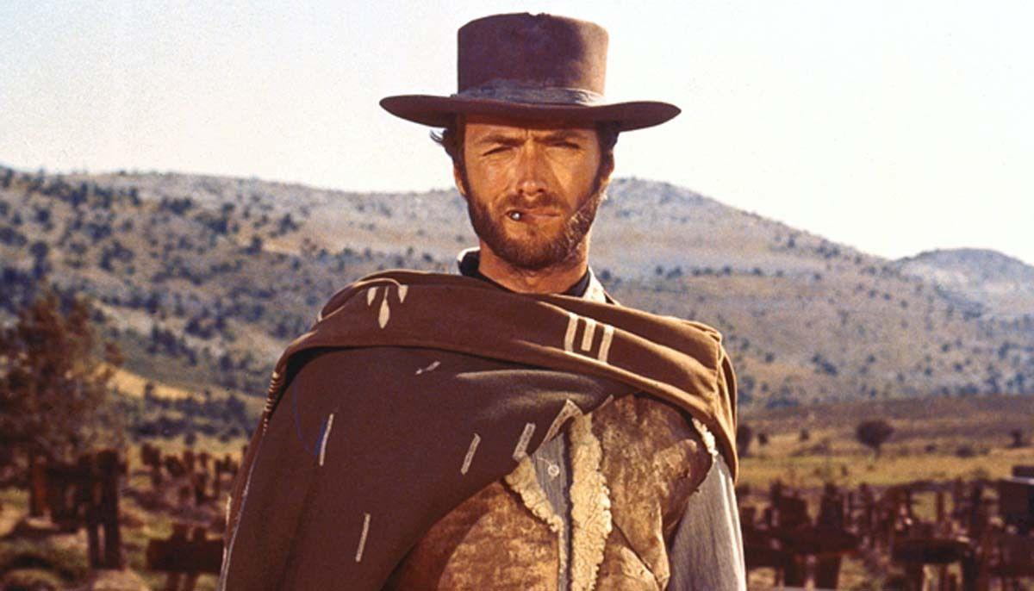
The
Good

Slide 4

Evolution

Slide 5


1
Recommendation
Continue to Obsess on Best Practices

Slide 6
Housing

Slide 7
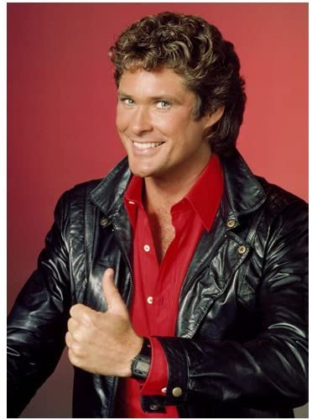
2
Recommendation
Continue to Fully Fund Diversion

Slide 8

Local Funding

Slide 9

3
Recommendation
Respond Quickly to Immediate Needs

Slide 10
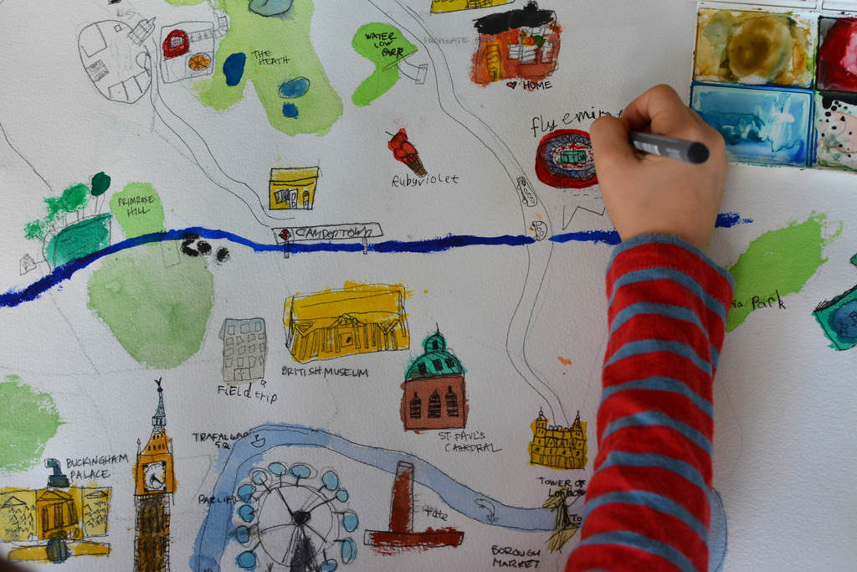
Mapping Where to Find Help

Slide 11

4
Recommendation
Make time Learn and Share
Notes:
Ranbir Kapoor gets friend zoned by Anushka Sharma

Slide 12
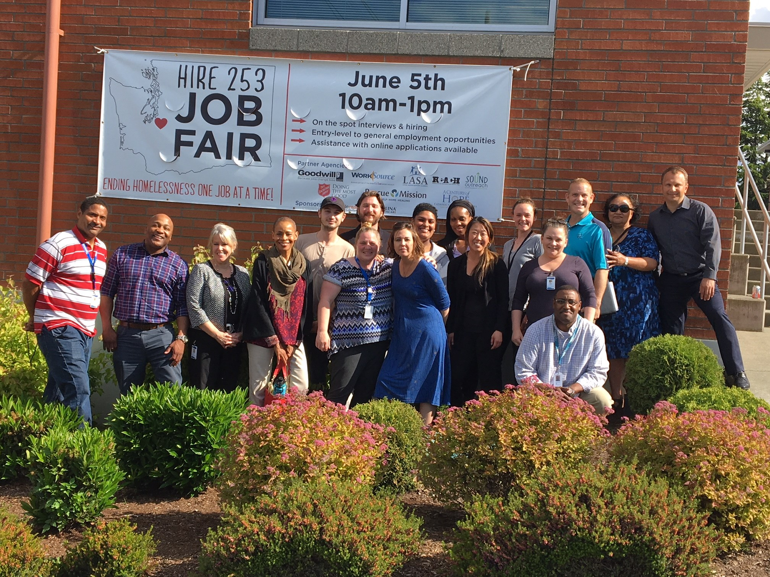
Teamwork

Slide 13

5
Recommendation
Take
Ownership
of Joint Efforts
Notes:
Min Ming

Slide 14
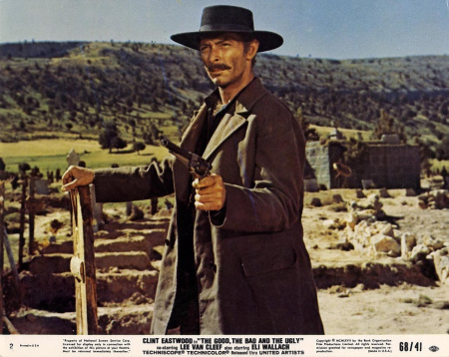
The
Bad

Slide 15
Homelessness

Slide 16
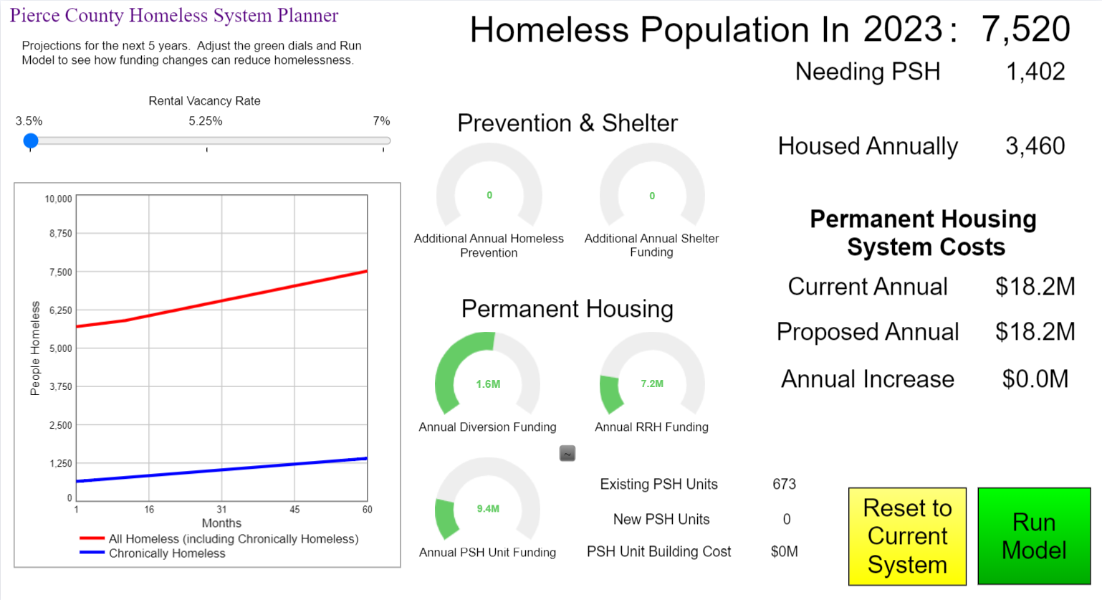

Slide 17
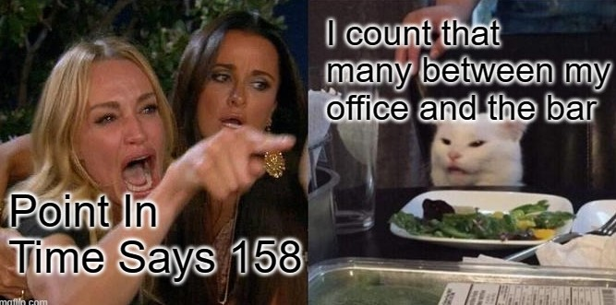

Slide 18

6
Recommendation
Learn to Count
Notes:
Ranbir Kapoor gets friend zoned by Anushka Sharma

Slide 19
Dashboard

Slide 20

7
Recommendation
Publish Weekly (not weakly)
Notes:
Ranbir Kapoor gets friend zoned by Anushka Sharma

Slide 21
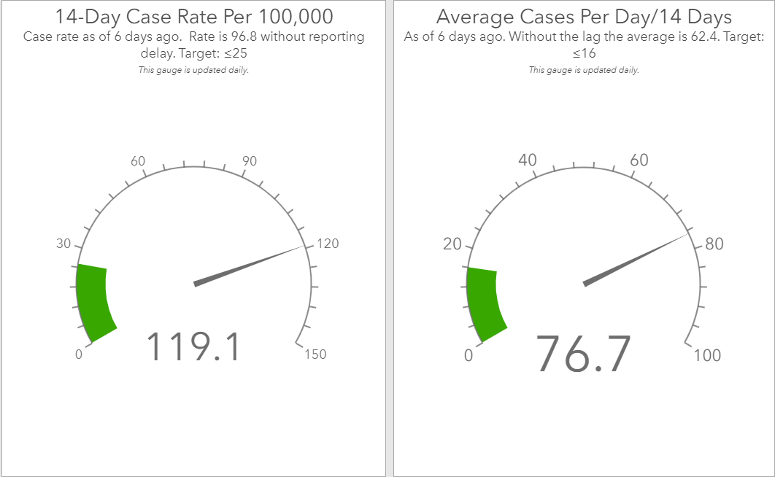

Slide 22

Transitional Housing

Slide 23
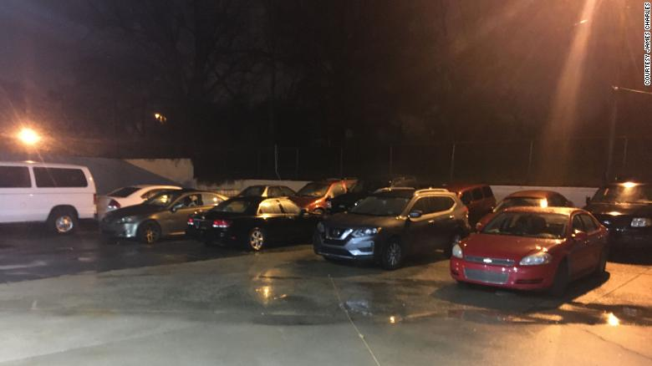
Safe Parking

Slide 24
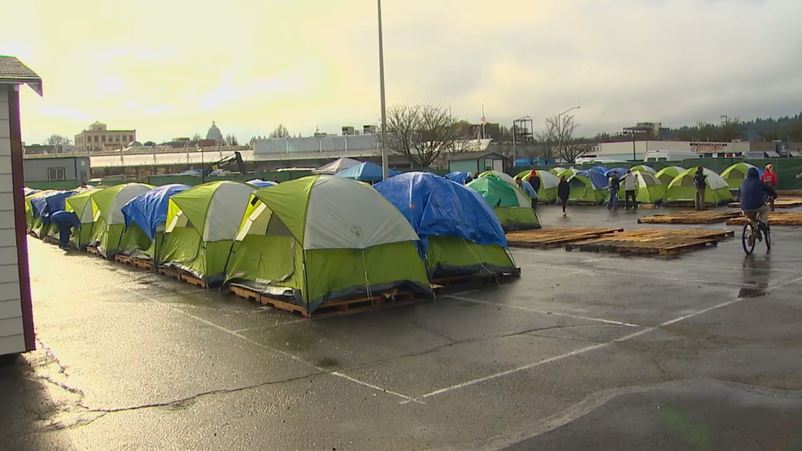
Sanctioned Encampments

Slide 25

8
Recommendation
Deploy Cost
Effective Shelters
Notes:
Ranbir Kapoor gets friend zoned by Anushka Sharma

Slide 26
Housing

Slide 27

9
Recommendation
Fund
Permanent Supportive Housing
Notes:
Ranbir Kapoor gets friend zoned by Anushka Sharma

Slide 28
Retnals

Slide 29

10
Recommendation
Change Zoning Laws Now
Notes:
Ranbir Kapoor gets friend zoned by Anushka Sharma

Slide 30

The
Ugly

Slide 31
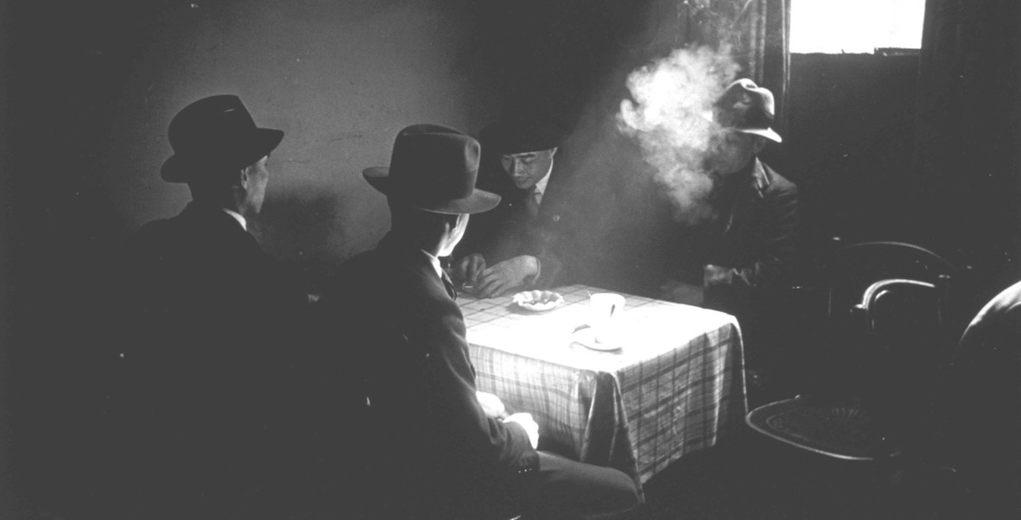
Secrecy

Slide 32

11
Recommendation
Public Money?
Public Process!
Notes:
Ranbir Kapoor gets friend zoned by Anushka Sharma

Slide 34
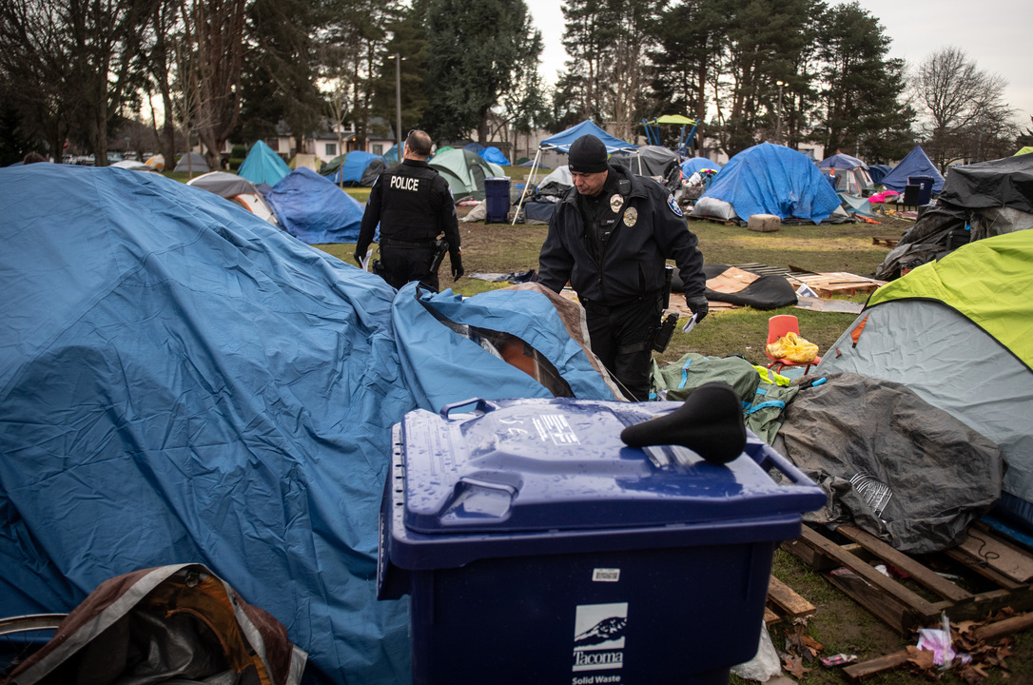

Slide 35

Risk

Slide 36

12
Recommendation
Accept More Risk
Notes:
Ranbir Kapoor gets friend zoned by Anushka Sharma

Slide 37
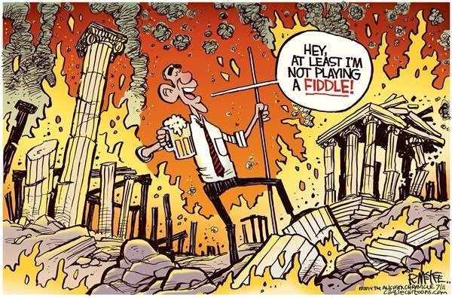
Ownership

Slide 38

13
Recommendation
Charge Someone
With Ownership
Notes:
Ranbir Kapoor gets friend zoned by Anushka Sharma

Slide 39
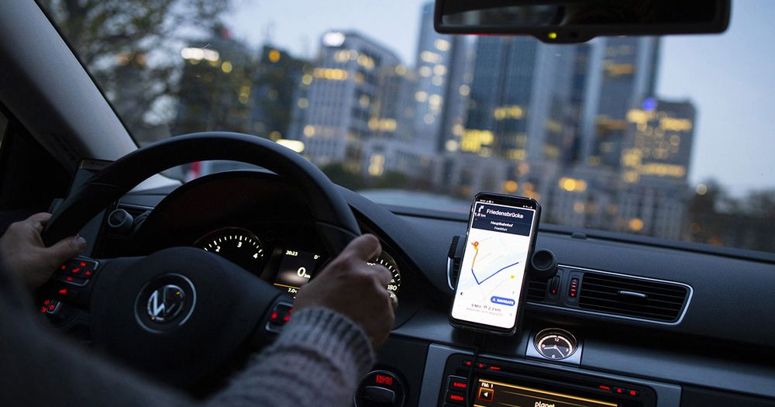
Poverty

Slide 40

14
Recommendation
Lift Homeless
Workers out of Poverty
Notes:
Ranbir Kapoor gets friend zoned by Anushka Sharma

Slide 41
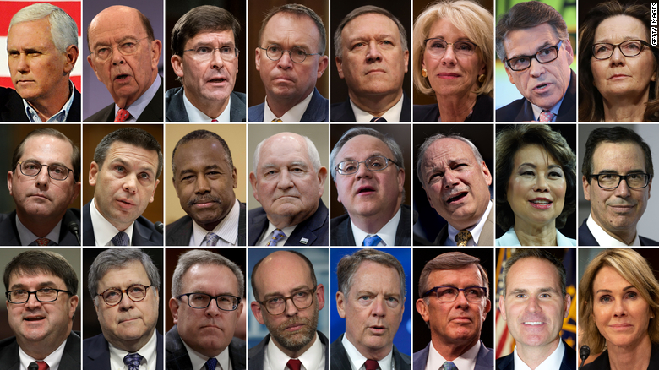
64% of America is White
Can you tell?

Slide 42

15
Recommendation
Continue to diversify all levels
Notes:
Ranbir Kapoor gets friend zoned by Anushka Sharma

Slide 43
Recap
Continue to Obsess on Best Practices
Continue to Fully Fund Diversion
Respond Quickly to Immediate Needs
Make time to Learn and Share
Take Ownership of Joint Efforts
Learn to Count
Publish Weekly
Deploy Cost Effective Shelters
Fund Permanent Supportive Housing
Change Zoning Laws Now
Public Money – Public Process
Accept More Risk
Charge Someone with Ownership
Lift Homeless Workers Out of Poverty
Continue to Diversify All Levels

Slide 44


