Slide 1
The Road to 2020
Tacoma Coalition to
End Homelessness
8 March 2019
Lorraine Ralston
Partnership Specialist
U.S. Census Bureau

Slide 2
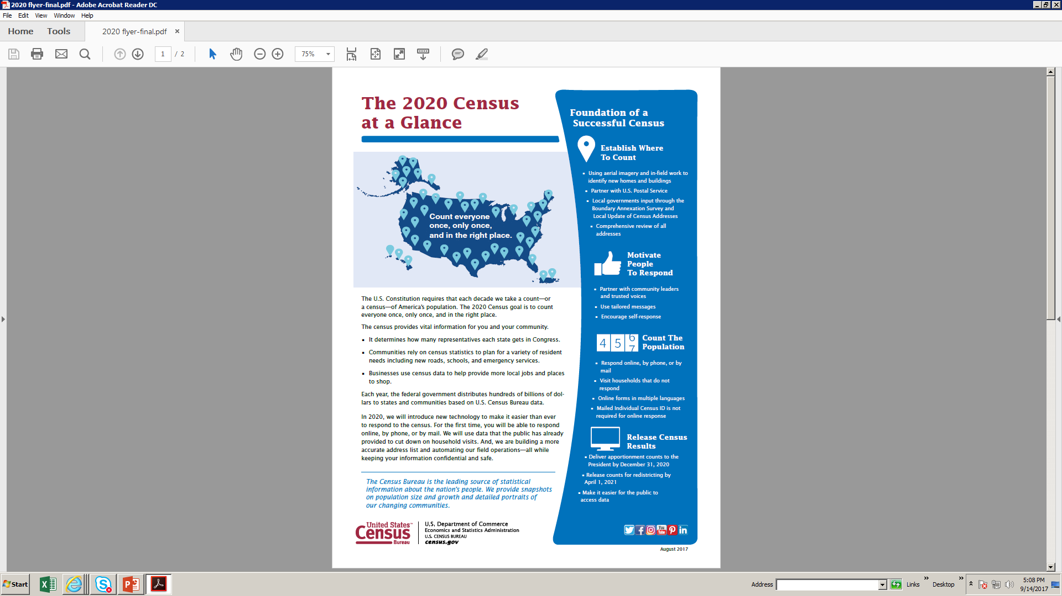
The Road to 2020
Census Day is
1 April 2020
389 DAYS
TO GO!

Slide 3
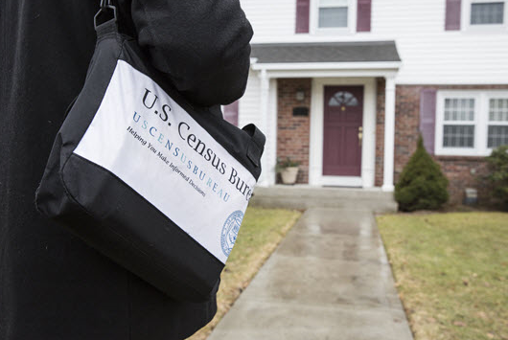
Why We Do a Census
Article 1,
Section 2
U.S. Constitution
“The actual Enumeration shall be made within three Years after the first Meeting of the Congress of the United States, and within every subsequent Term of ten Years, in such Manner as they shall by Law direct.”

Slide 4
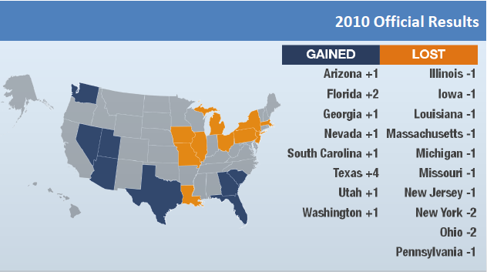
U.S. House of Representatives
435 Total Representatives | 10 Representatives in Washington

Slide 5
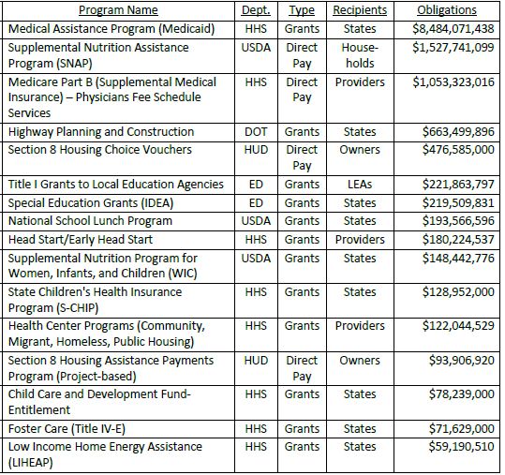
Funding
16 Largest Federal Programs that Distributed Funds Based
on Census Data (2015)
Counting for Dollars
WASHINGTON
Total = $13,722,789,945
Per Capita = $1,914 *
* Total Fiscal Year 2015 obligations for the 16 programs divided by the population
as of 1 July 2015
(per the Census Bureau)
Source: Reamer (2017). Counting for Dollars 2020: The George Washington University

Slide 6
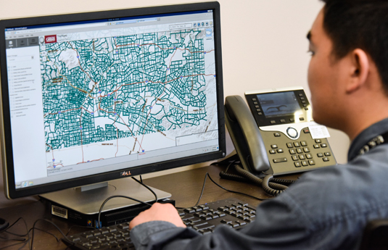
Other Uses of Census Data
State legislative districts, school districts, voting precincts
State, local and tribal governments planning decisions
Business and nonprofit decisions (where to locate, size of market)
Local trends
Population benchmarks

Slide 7




What’s New for 2020
Optimizing Self-Response
  Internet (45%)
  Toll-free Number
  Paper
Re-engineering Address Canvassing (only about 30% done in the field)

Slide 8

What’s New for 2020
Using high-quality data from trusted sources to reduce in-person follow up
More automation (field workers to use
mobile devices)

Slide 9

The Road to 2020
2018-2019
2020
Mar-Jun 2020
31 Dec 2020

Slide 10

What Do We Ask?
Address
Phone Number
Count of Each Person At That Address
Name
Gender
Age and Date of Birth
Race
Hispanic, Latino or Spanish Origin
Whether Someone Lives Somewhere Else
Relationship
Citizenship *

Slide 11
Languages
Internet Self-Response | Paper Form | Questionnaire Help | Enumerators, Mailed Items | Language Card and Guides
English Spanish Chinese (Simp.) Vietnamese Korean Russian Arabic Tagalog Polish French Haitian Creole Portuguese Japanese | English Spanish | 13 languages Plus TDD | English Spanish | 59 languages Plus ASL Plus Braille Plus Large Print

Slide 12
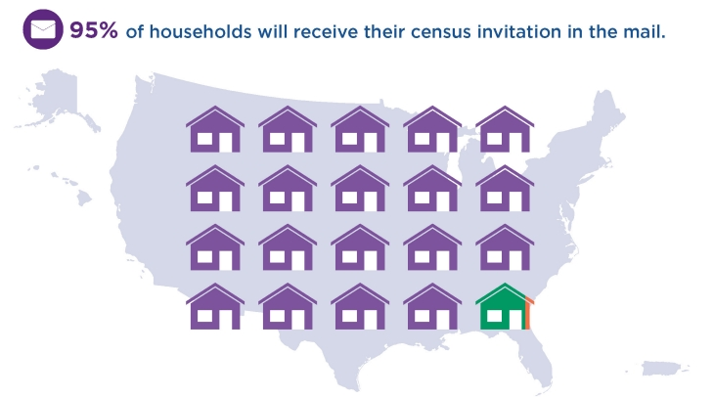
How It Will Work
Nearly every household will receive
an invitation to participate from a postal worker or a census worker

Slide 13
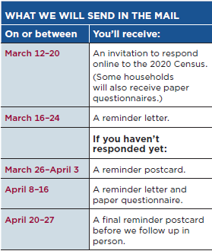
How It Will Work

Slide 14

Private and Confidential
Only aggregate data reported
Prohibited by law from releasing personal information to any person or organization (USC, Title 13) *
Life-time oath by all Census Bureau employees
Penalties for wrongful disclosure: up to 5 years
imprisonment and/or a fine of $250,000

Slide 15
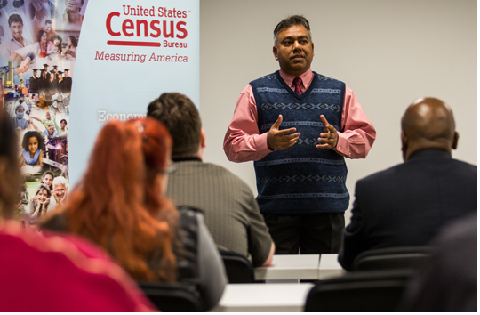
Working Together
  Educate people about the 2020 Census and foster cooperation with enumerators
  Encourage people to
  self-respond
  Engage organizations
  to reach out to
  hard-to-count groups
  and those who
  aren’t motivated to
  respond to the
  national campaign

Slide 16
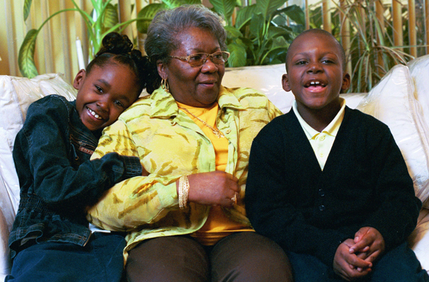
Hard-to-Count Populations
Foreign-born/Immigrants
Children younger than 5
Seniors
Homeless
Migrant workers
Renters
Low internet access

Slide 17
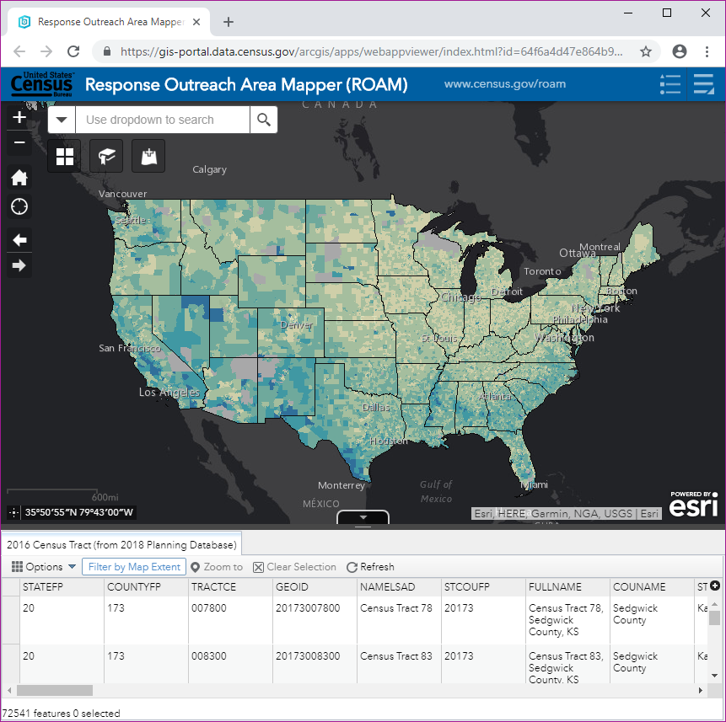
ROAM
Response Outreach Area Mapper
Public application that displays characteristics of hard-to-count area
Census tract level
www.census.gov/roam

Slide 18
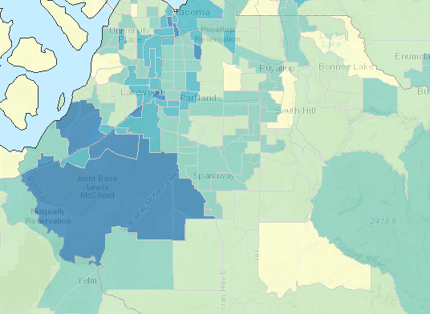
ROAM : Pierce County

Slide 19
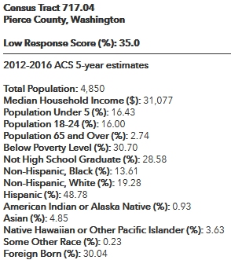
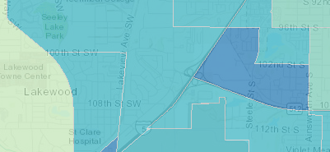
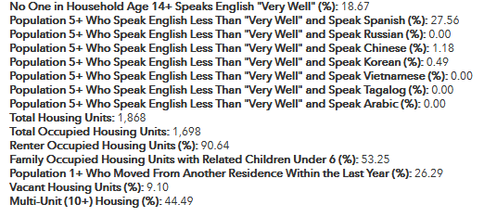
ROAM Data

Slide 20
Counting the Homeless
Service-Based Enumeration: count people who do not have a usual residence and often get assistance/meals from service-based locations
Count people where they live on Census Day (or where they are staying on Census Day if they have no permanent place to live)

Slide 21
Counting the Homeless
The Census Bureau does NOT ask people if they are experiencing homelessness.
The Census Bureau does NOT produce or publish an official count of the population experiencing homelessness.

Slide 22

Where We Count
Where people receive services
  Emergency or
  Transitional Shelters
  Soup Kitchens
  Mobile Food Vans
  Targeted Non-sheltered Outdoor Locations (parks, alleys, under highway bridges, transportation depots, all-night businesses such as laundromats)

Slide 23

How We Count
Update list of all service-based locations
Confirm outdoor locations
In-person interviews
Treat people with dignity and respect at all times

Slide 24

When We Count
Three Days:
27, 30 and 31 March 2020 (tent)
Can conduct the count in evenings
if needed

Slide 25

How You Can Help
Help promote the 2020 Census
Let people know enumerators will be coming to conduct the count
Encourage people to participate; explain why it is important to be counted
Reassure people that all information is kept confidential

Slide 26
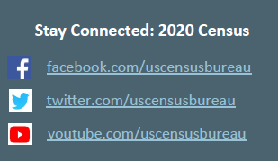
Good Ideas
Put a link for jobs on your website
Put 2020 Census information on your website
Activate social media
Put a 2020 Census
message on your
organization voicemail
Census kiosk
Put up Census posters and flyers

Slide 27

Good Ideas
Publish articles in your newsletters
Print messages on bills (e.g., electric bills)
Host a Census event
E-blast to employees
Celebrate One Year to
Go on 1 April 2019
Resolution/Proclamation

Slide 28
Thank You!
Lorraine Ralston
Partnership Specialist
U.S. Census Bureau
lorraine.m.ralston@2020census.gov
253.905.8348

